Slide 1

Heart Disease: The Path to its Prediction
Exploring Use of Machine Learning for Prediction
John Katsoulakis

Slide 2
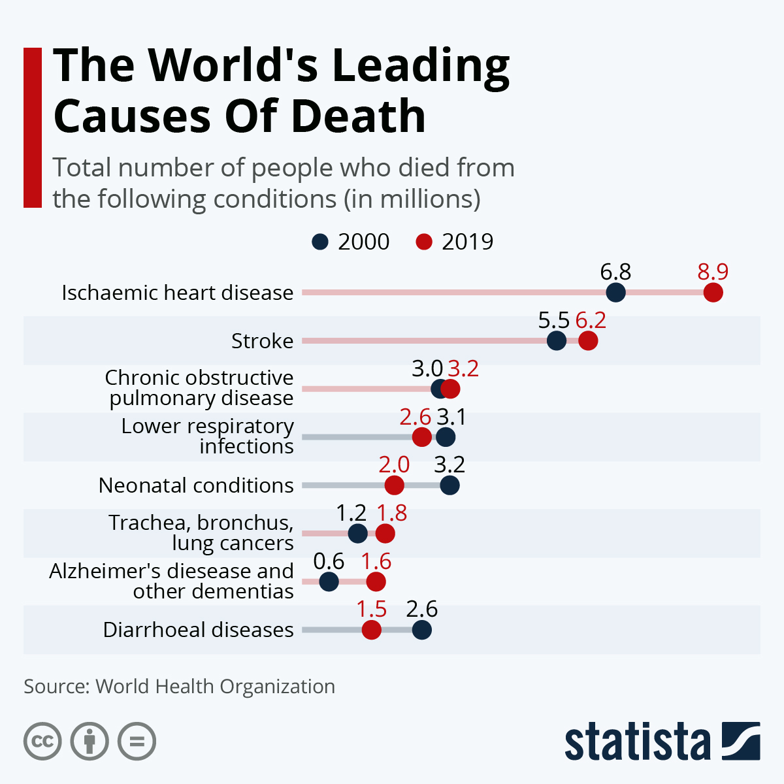
Heart Disease and stroke (HD) the leading causes of death globally
Why is prediction of a heart disease important?
The leading cause of death globally
9 million people died from heart disease in 2019
30% increase in the number of deaths over 20 years
What is this project about ?
A student’s attempt to predict accurately whether a person has a heart disease or not applying machine-learning modeling into real-world data

Slide 3
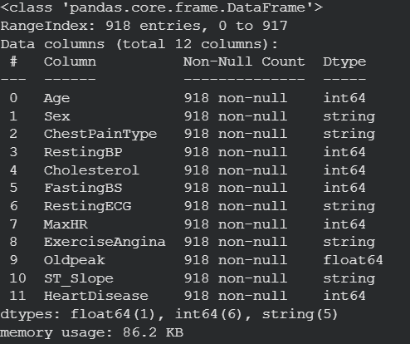
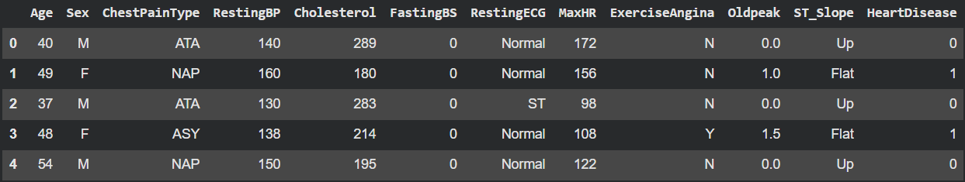
Ten different predictive variables of different types used Both demographics (e.g., age) and health-related (e.g., total cholesterol)
Demographics
Health metrics

Slide 4
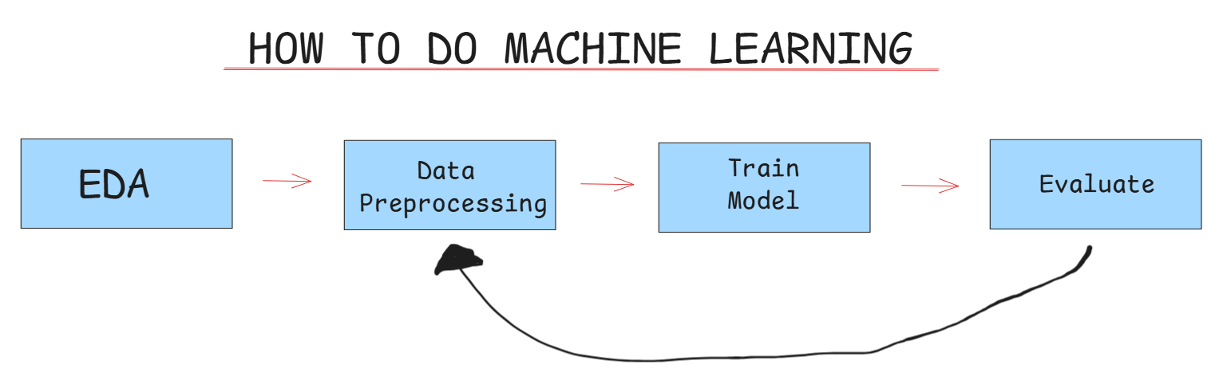
A four-step process leveraging Machine Learning
A four-step process
Exploratory Data Analysis (EDA)
Data Cleaning & Preprocessing
Model Selection & Training
Results & Evaluation

Slide 5
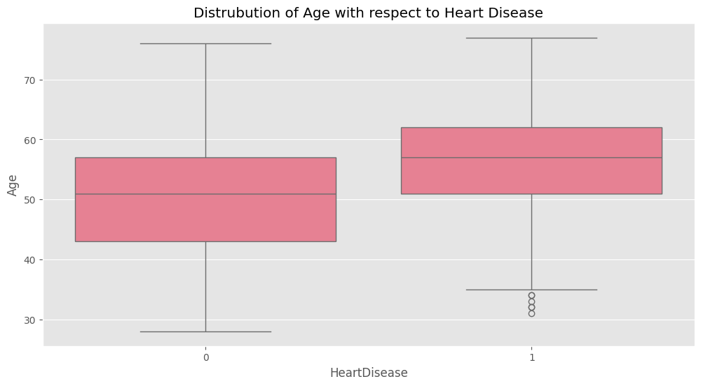
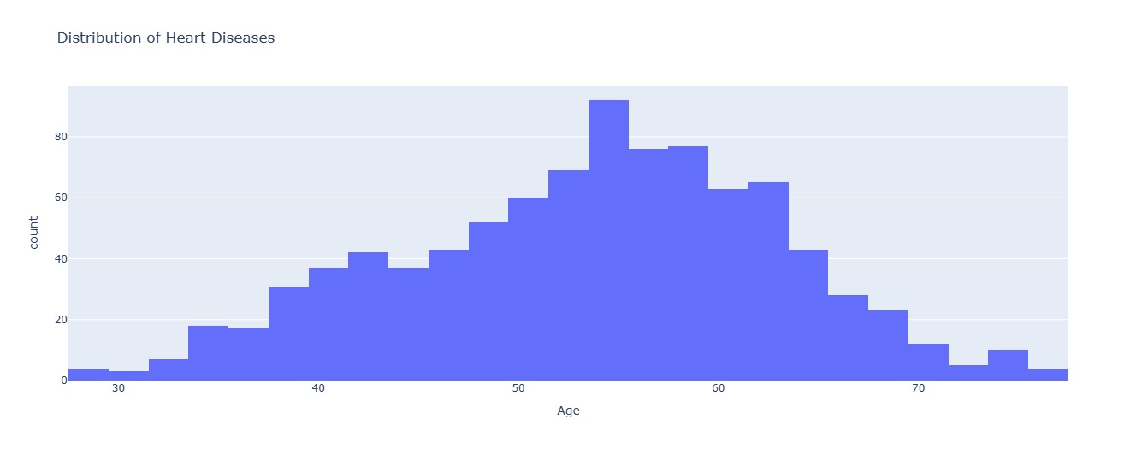
1
EDA: Analyzing the data distribution for each variable and… …checking for outliers
Data Analysis : Age distribution by people-group
57 y.o. the median age for patients with heart disease
Those with heart disease are, on average, older by 5 years
Still there are four outliers – patients younger than 36 years old having heart disease
NO HD
YES HD
Data Analysis : Age outliers in patients with heart disease
Majority of patients with heart disease between the ages of 52 and 62
Still, there are four outliers – patients younger than 35 years old having heart disease

Slide 6
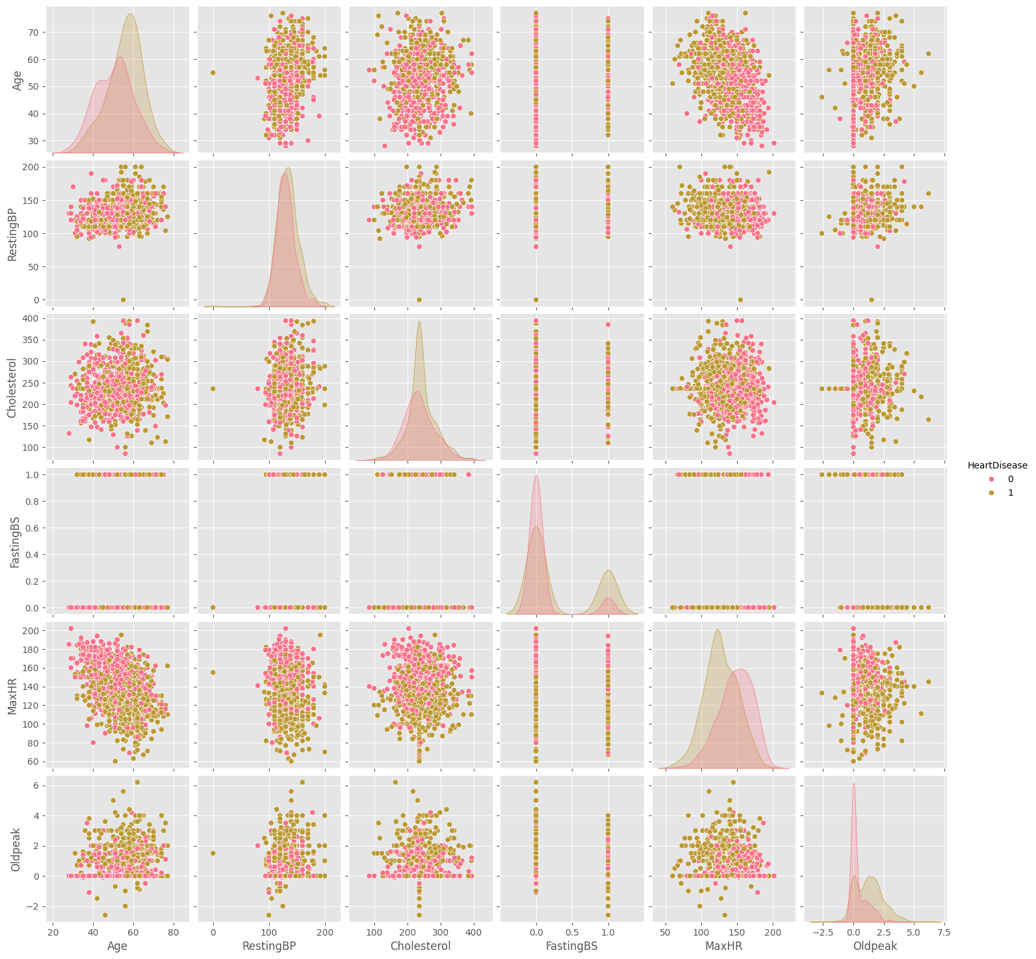
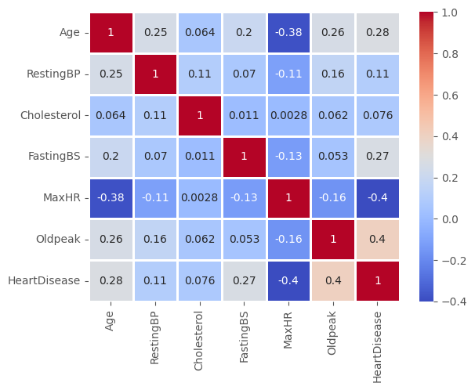
1
EDA: Using pair-plots and correlation tables Oldpeak the best single predictor of Heart Disease followed by Age
Pair-Plots
Correlation tables

Slide 7
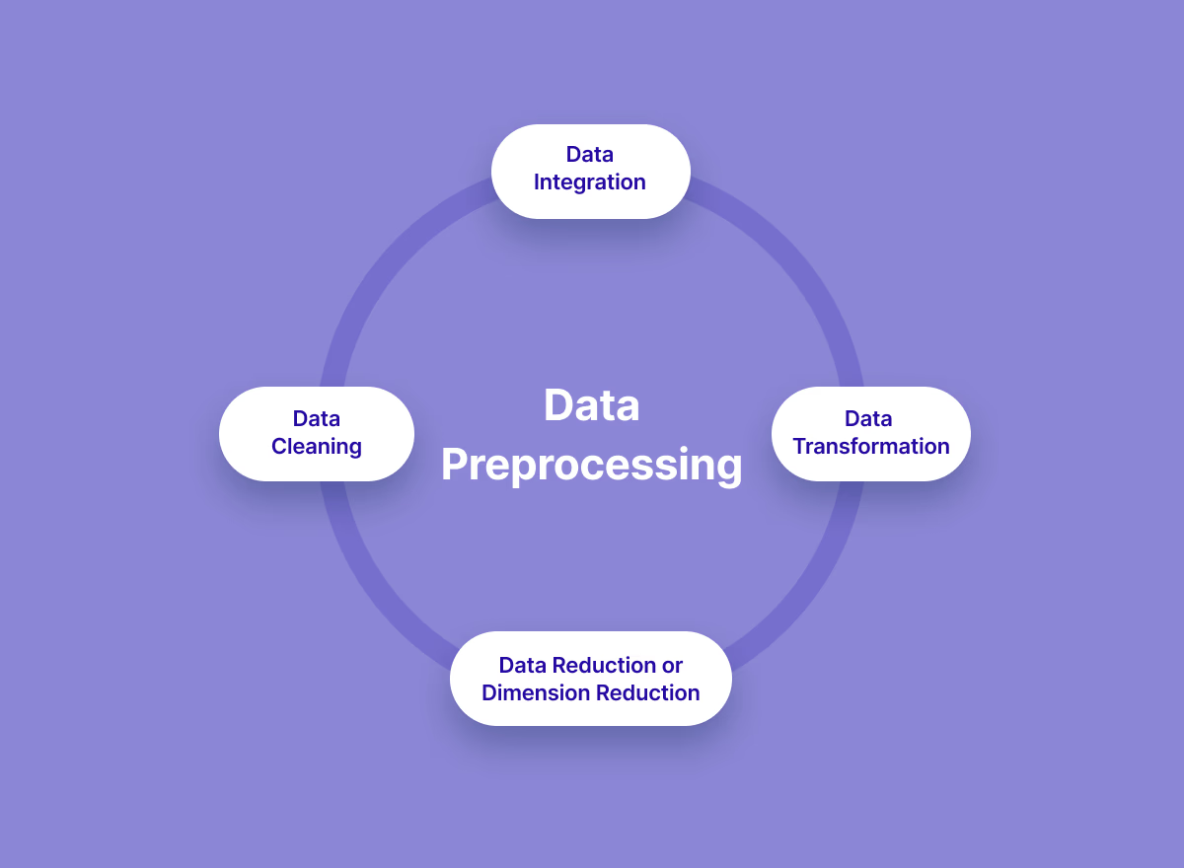
2
Data cleaning and pre-processing: 4 sub-steps followed
Data…
Cleaned for any anomalies or wrong texting
Integrated into the database replacing zeros or null values with means or averages
Transformed through scaling (e.g., logarithmic transformation) to smoothen out differences
Reduced if, even after scaling, unusual outliers exist that may generate bias to the model
2b
2a
2c
2d

Slide 8
3
Model Selection and Training 6 ML models used to predict whether a person has heart disease or not
3a
Tree-Based Models
3b
Non-Tree Based Models
Decision Trees
Random Forests
K Nearest Neighbors (KNN)
Support Vector Machine (SVM)
Logistic Regression
Naïve Bayes Classifier
In all models we used a train-test split to allocate the data into a testing and a training set

Slide 9
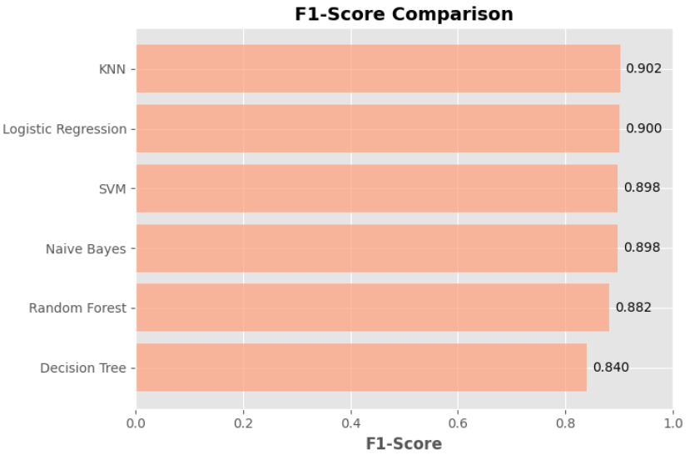
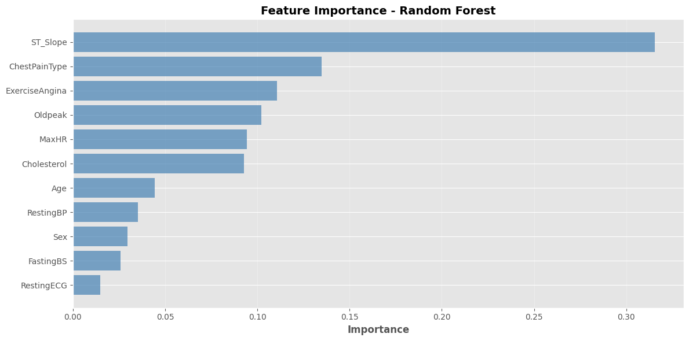
4
Model Results and Assessment: A process of three sub-steps Random Forest best model after tuning with chest pain the most critical predictive feature
Step 4a: Initial assessment
Step 4b: Fine-tuning
Step 4c: Feature significance
Model Name | F1 Score
Random Forest | 0.8836
Support Vector Machine (SVM) | 0.8834
K Nearest Neighbors (KNN) | 0.8812
KNN model seems to perform better overall
It is followed by Logistic Regression and SVM with minor differences
Decision tree with lower classification performance
Model adjustments through five-fold cross-validation and hyperparameter tuning
Following tuning, Random Forest and SVM appear to be the best models classifying people best equally well
Type of chest pain and exercise angina the features with highest predictive importance
Demographics such as age and gender seem to have smaller predictive significance
Unexpectedly, total cholesterol seems to also have rather average importance

Slide 10
As a Summary
In this project we :
Looked through the dataset and distinguished specific patterns
Split the dataset into training and testing
Trained and Tested the models and calculated some metrics to determine the most useful

